Slide 1



Центр цифрових інновацій
NOSC-UA DIH
Кирило Гороховський, СТО

Slide 2

Partners
Coordinator (Networked, cluster organization)
Kyiv Academic University (KAU), NAS of Ukraine
Coordinator website: https://kau.org.ua/en
Organizational form: (part of) Public organization
(part of RTO, or university)
FACULTY OF COMPUTER SCIENCES of
National University of Kyiv-Mohyla Academy
Partner Type University
Website https://www.ukma.edu.ua/eng
ISOLUTIONS LLC Ukraine
Partner Type SME
Website https://isolutions.com.ua
Agency of European innovations
Partner Type NGO
Website https://aei.org.ua

Slide 3
Services
Education and skills development
Accessing the digital technologies and services offered by the EGI and EOSC at national level
Ecosystem building, scouting, brokerage, networking
Technology transfer
Cloud technologies
Compute
Storage and Data
Security
Applications
Training
Blockchain
Architecture design for blockchain-based software systems
Development of private blockchains using HyperLedger Fabric
Business consulting for government, energy, ehealth and fintech sectors on usage of blockchain technology for ledgers
AML consulting for banks, finmoninoring and law enforcement authorities
Consultancy on use of blockchain platform for cybercrime evidence artifacts ledger
NFT-based projects – digital art marketplace
Cybersecurity
DDoS protection for SME
EDR Endpoint Detection and Response
SOC (EDR and e-discovery)
PABX and VoIP Security
PAM Privileged Access Management
Security Policy Maintenance
AI
Research of datasets and propose of approach
Neural network modelling, testing and training
Application development
Cloud service for Neural network tasks calculation
Business consulting for ML implementation

Slide 4
Introduction to Data Spaces

Slide 5






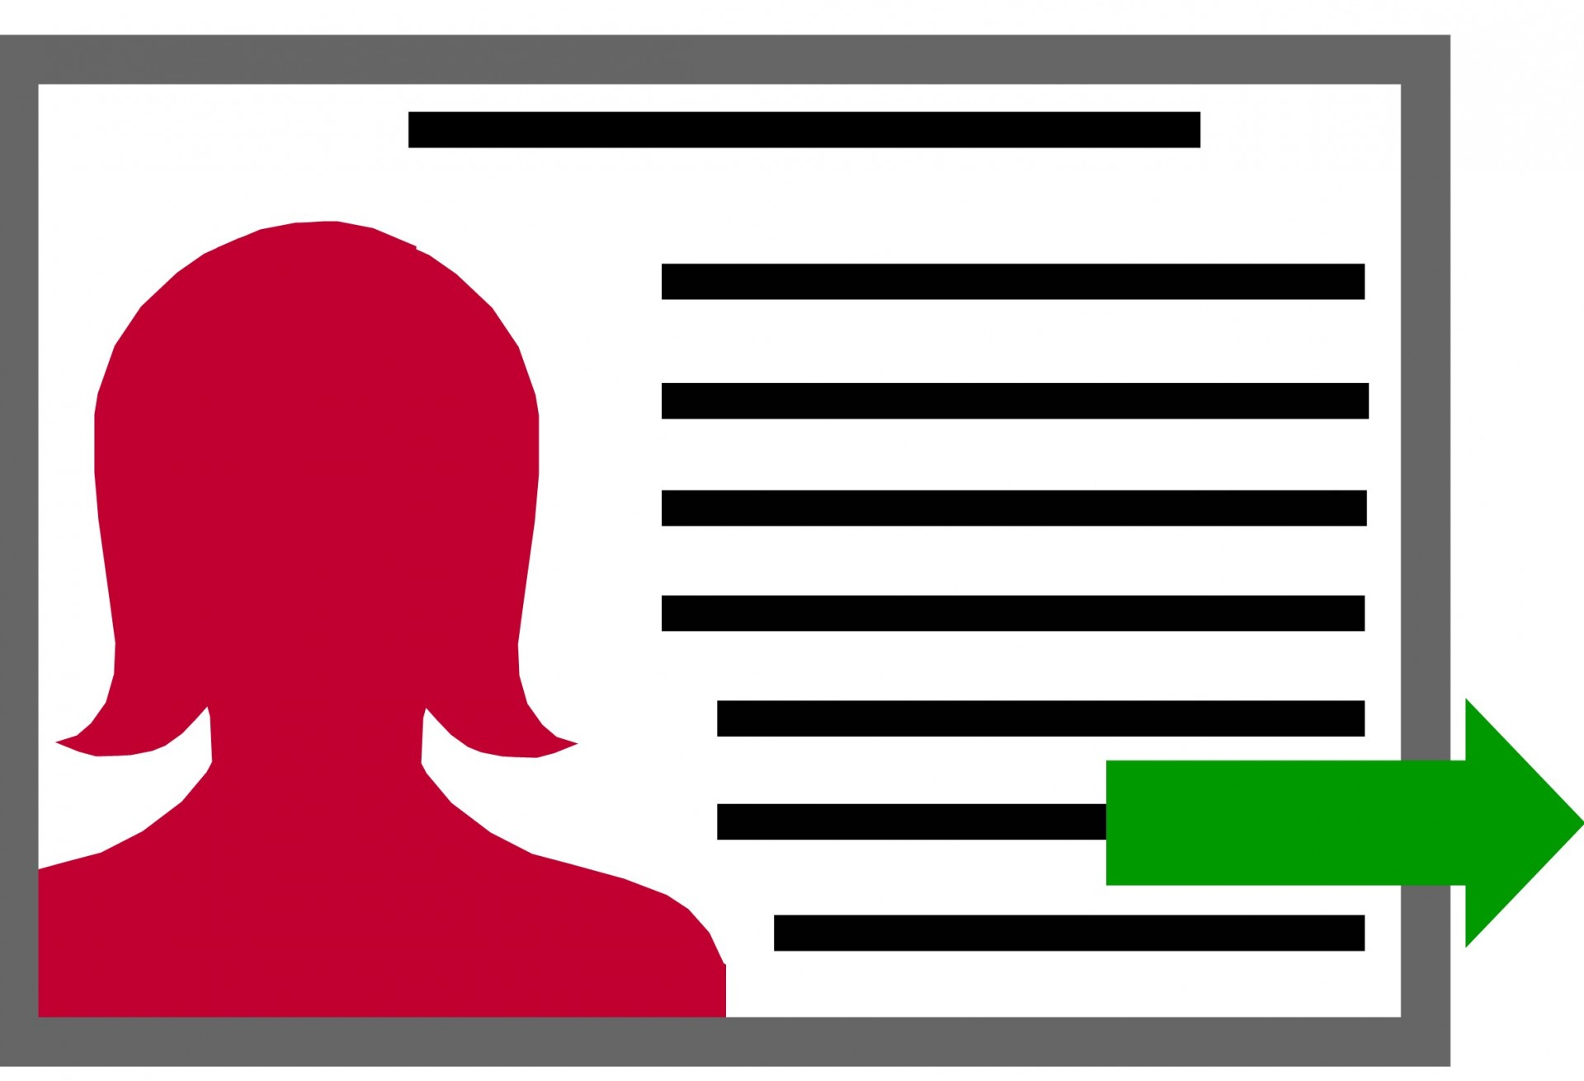

A data space is an decentralized data ecosystem built by the parties with common purpose
Further, it can be defined as a decentralized data ecosystem built around commonly agreed building blocks enabling an effective and trusted sharing of data among participants.
Data consumers, data providers and identity and authorisation service providers form an ecosystem with a governance structure in place to create a basic data space
Additionally, service providers like Marketplaces, Brokers, Billing and Clearing etc. can be part of data space to support variety of use cases
In i4Trust iSHARE and FIWARE bring the necessary components along with basic governance structure to create the i4Trust data space
Data Space
Data Consumers
Data Providers
Identity and Authorisation service providers
Data Space Governance
Marketplace and other service providers

Slide 6
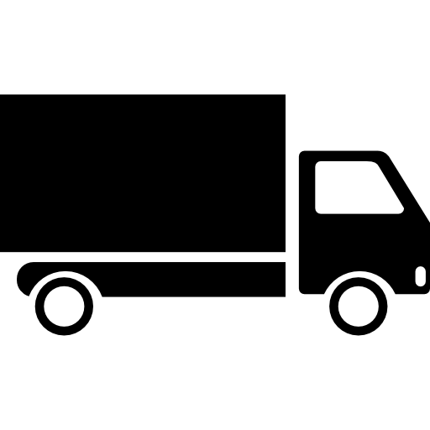
Data spaces are build around real businesses
Agreeing on 1. Data interoperability
2. Data sovereignty 3. Data value creation 4. Governance
Within sectors, verticals the real potential lies to create value through for example
Exchange of hidden data to save time, money and irritation
Allowing AI to run on long value chains to provide new insights
Save emissions

Slide 7
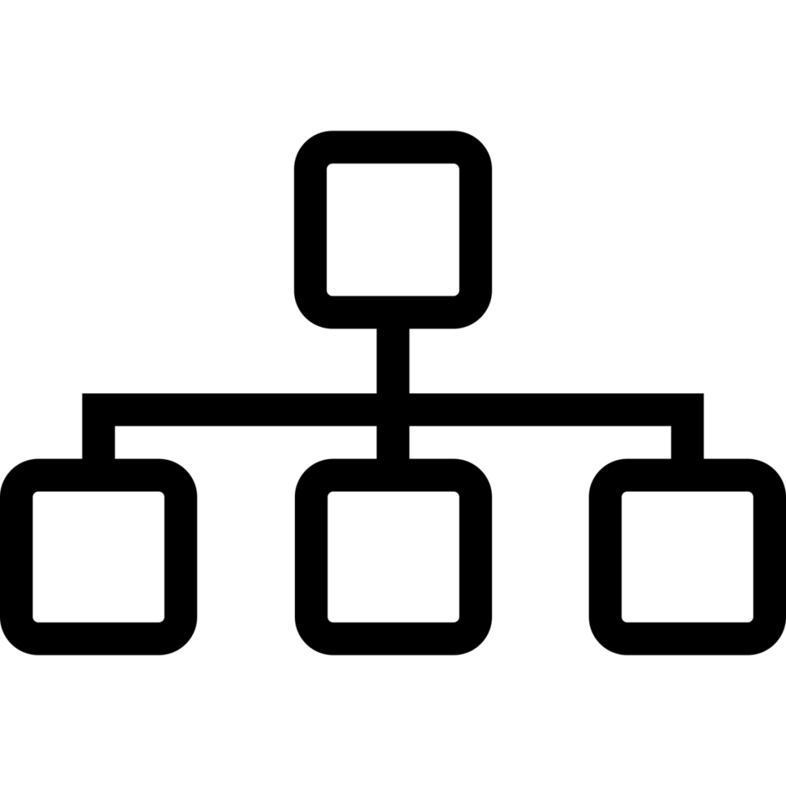







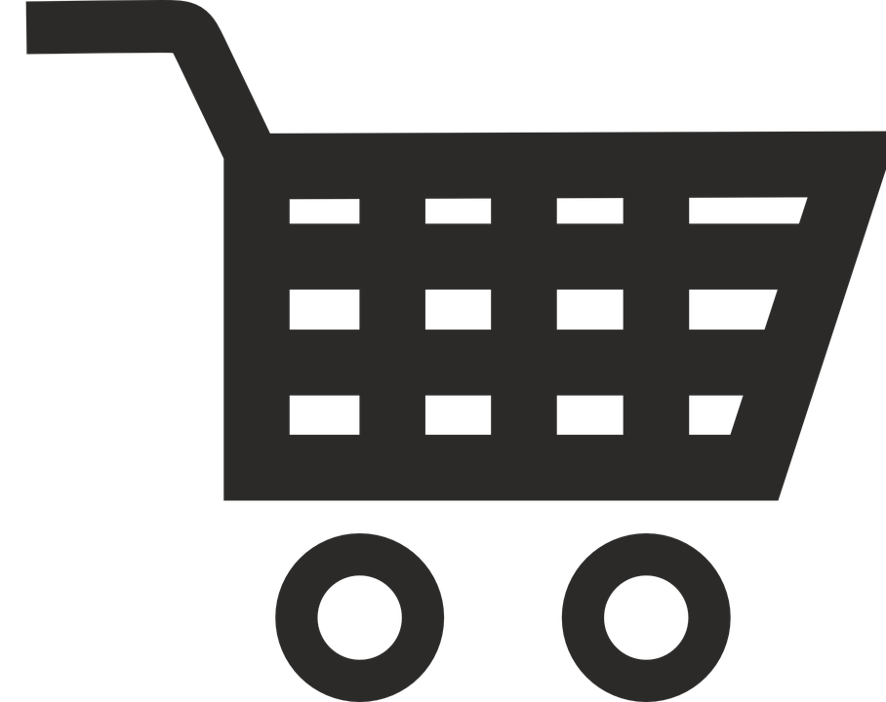

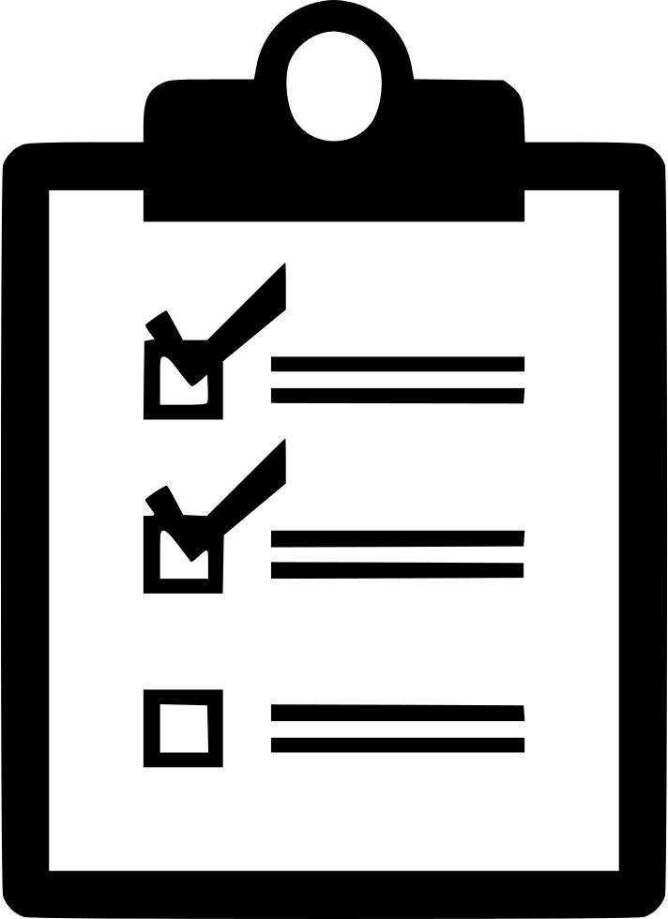


Data Spaces Building Blocks
Data Interoperability
Data Sovereignty and Trust
Data Value Creation
Data Spaces Governance
Data Models & formats
Identity Management
Metadata & Discovery Services
Business Agreements
Data Exchange API
Trusted Exchange
Publication & Marketplace Services
Operational Agreements
Provenance & Traceability
Access & Usage Control/Policies
Data Usage Accounting
Organizational Agreements
Technology Building Blocks

Slide 8
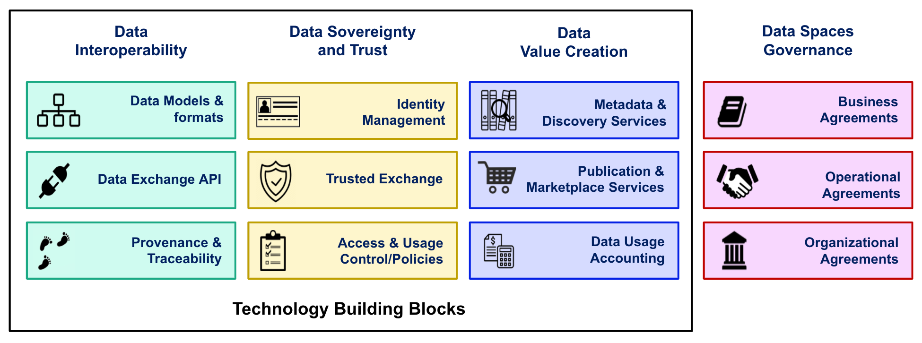
Data space building blocks
Data Interoperability - Data spaces should provide a solid framework for an efficient exchange of data among participants, supporting full decoupling of data providers and consumers.
Data Sovereignty and Trust - Data spaces should bring technical means for guaranteeing that participants in a data space can trust each other and exercise sovereignty over data they share.
Data Value Creation - Data spaces should provide support for the creation of multi-sided markets where participants can generate value out of sharing data (i.e., creating data value chains).
Data Spaces Governance- Data spaces governance should also provide for the non-technical aspects like business agreements, operational agreements and organisational agreements and a governing body for data spaces to provide certainty and sustainability to its participants.
Notes:
Add the icons of the standards used in each block

Slide 9
Examples of data spaces in real life
Data space logistics : saving CO2 and handling time for goods by working under the same trust framework and based on the same standards. And provide ad hoc access to the data of goods in case of emergencies.
Data space Energy : protecting data sovereignty while allowing energy saving services on the data generated by buildings.
Data space building : providing access to the detailed materials needed and on that basis provide a better planning, smoother building process and better insights in the circularity of the build.

Slide 10
How data space building blocks are materialized in i4Trust

Slide 11


i4Trust: open source, mature technologies
Data Interoperability
Data Sovereignty and Trust
Data Value Creation
Data Spaces Governance
Data Models & formats
Identity Management
Metadata & Discovery Services
Business Agreements
Data Exchange API
Trusted Exchange
Publication & Marketplace Services
Operational Agreements
Provenance & Traceability
Access & Usage Control/Policies
Data Usage Accounting
Organizational Agreements
Technology Building Blocks

Slide 12
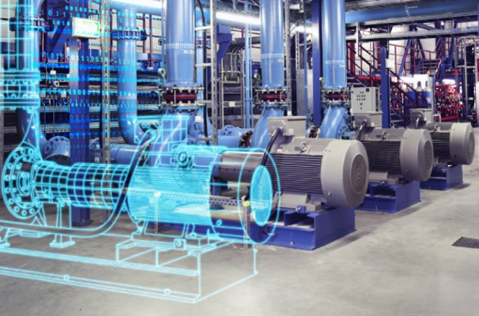

i4Trust: fundamental principles
Fundamental principle in Data Spaces for a Data Economy:
Data providers publish data resources knowing that consumers, unknown “a priori”, know how to consume them
Data consumers know how to discover and consume data resources published by data providers
This requires all participants to “speak the same language”:
Data exchange API (the sentences you construct)
Standard data models (what you speak about)
Common mechanisms for Identity and Access Management (IAM) (who speaks under what rules)
i4Trust focuses on secure exchange between smart applications which exchange context / digital twin data:
Digital Twin = Digital representation of an real-world asset
Digital Twin data = Properties, Relationships
Context = Collection of Digital Twins
IAM at organization and user level, have a Trust Authority
Data Marketplace and Publication services
Smart City
?
Smart Building
Smart Port

Slide 13
What are we referring to as Digital Twin?
Digital Twin = Digital representation of an asset
Characterized by attributes
Properties
Relationships (Linked Data)
Values of attributes may change over time (or not)
Typically have a location (but it is not a must requirement)
(digital representation of) Context = Digital Twins Collection
Cornerstone for the development of interoperable and replicable (portable) Smart Solutions:
Standard API for getting access to Digital Twin data (context)
Common Data Models associated to Digital Twin classes
FIWARE has driven standardization+adoption:
NGSI: ETSI NGSI-LD API (based on initial NGSIv2)
Smart Data Models initiative (500+ data models)

Slide 14








Effective and trusted data sharing
iSHARE Satellite
IdP
Auth
Context Consumers
Smart Building
IdP
Auth
Context Broker
Context Broker
Context Consumers
Smart City
Data Space
Marketplace / Publication Platform
IdP
Auth
Smart Port
Context Broker
Context Producers

Slide 15



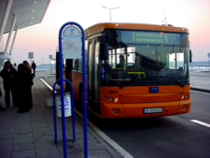
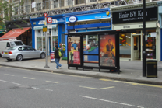


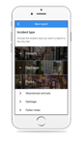
Data Exchange API: ETSI NGSI-LD
Application/Service
Shop
Location
Business name
Franchise
offerings
FIWARE NGSI API (NGSIv2 → NGSI-LD)
Citizen
Birthday
Preferences
Location
ToDo list
Context Broker
Entities (Digital Twins)
Bus
Location
No. passengers
Driver
Licence plate
Shop
Location
Business name
Franchise
offerings
Incident / claim
Date
Location
Type
Issuer
Description
Citizen
Name-Surname
Birthday
Preferences
Location
ToDo list
Bus
Location
No. passengers
Driver
License plate
Attribute

Slide 16
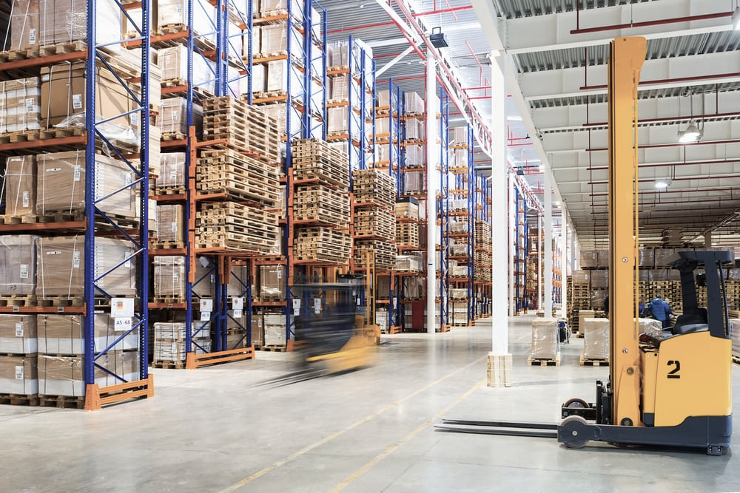
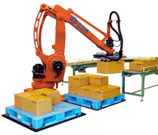
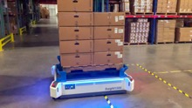

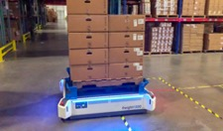
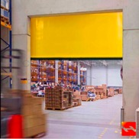


Data Exchange API: ETSI NGSI-LD
Application/Service
FIWARE NGSI API (NGSIv2 → NGSI-LD)
Palletizer robot
id
product
Items quantity
Layers
Size
Weight
Transport robot
Id
location
speed
transported items
destination
Context Broker
Entities (Digital Twins)
Transport robot
Id
location
speed
transported items
destination
Palletizer robot
Id
product
Items quantity
La<yers
Size
weight
Operator
Id
Location
Assigned task
Profile
Operator
Id
location
assigned task
profile
Shopfloor Door
Id
location
status (open/close)
Attribute

Slide 17
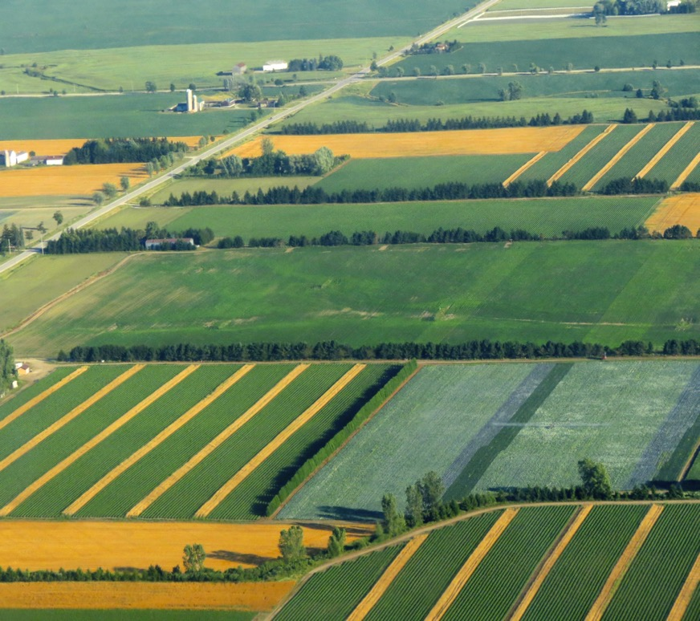

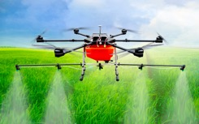





Data Exchange API: ETSI NGSI-LD
Application/Service
FIWARE NGSI API (NGSIv2 → NGSI-LD)
Crop
Humidity
Leaf area
Age
Drone
Location
Battery level
Speed
Planed route
Context Broker
Entities (Digital Twins)
Tractor
Location
Speed
Planed route
Drone
Location
Battery level
Speed
Planed route
Tractor
Location
Speed
Planed route
Crop
Humidity
Leaf area
Age
Attribute
‹#›

Slide 18








Data Exchange API: ETSI NGSI-LD
Application/Service
Patient
id
location
patient record
treatment
FIWARE NGSI API (NGSIv2 → NGSI-LD)
Surgery Room
id
hospital
equipment
surgery plan
Doctor
id
specialties
location
visits plan
Context Broker
Entities (Digital Twins)
Ambulance
license plate
location
speed
equipment
current alert
Surgery Room
id
hospital
equipment
surgery plan
Hospital
name
address
total patient rooms
occupied patient rooms
total surgery rooms
occupied surgery rooms
Ambulance
License plate
location
speed
equipment
current alert
Alert
alert id
emergency level
description
location
patient id
Attribute
‹#›

Slide 19





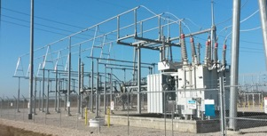
Data Exchange API: ETSI NGSI-LD
Application/Service
Energy Storage
active power
reactive power
SoC
SoH
FIWARE NGSI API (NGSIv2 → NGSI-LD)
Context Broker
Entities (Digital Twins)
Wind Turbine
location
power
wind speed
pitch angle
Wind Turbine
location
power
wind speed
pitch angle
Smart Home
location
address
installed PV
energy consumption
Substation
Hi voltage
Lo voltage
nominal power
power flow
Wind Plant
Location
Active Power
Reactive Power
Frequency
Attribute

Slide 20
Data Exchange API: ETSI NGSI-LD
Application/Service
NGSI-LD is a simple yet powerful REST API
Simple: simple operations are rather simple, what you would expect in a RESTful API
Entity types, entities, attributes have a path
You perform standard GET, POST, PUT, PATCH, DELETE operations
Yet powerful: powerful operations supported
Geo-queries
Subscription / Notification
Pull/Push styles for gathering data
Multiple data ”renderings” (key value, normalized, GeoJSON)
Temporal operations
Federation mechanisms
FIWARE NGSI API (NGSIv2 → NGSI-LD)
Context Broker
Wind Turbine
location
power
wind speed
pitch angle
Smart Home
location
address
installed PV
energy consumption
Wind Plant
Location
Active Power
Reactive Power
Frequency

Slide 21
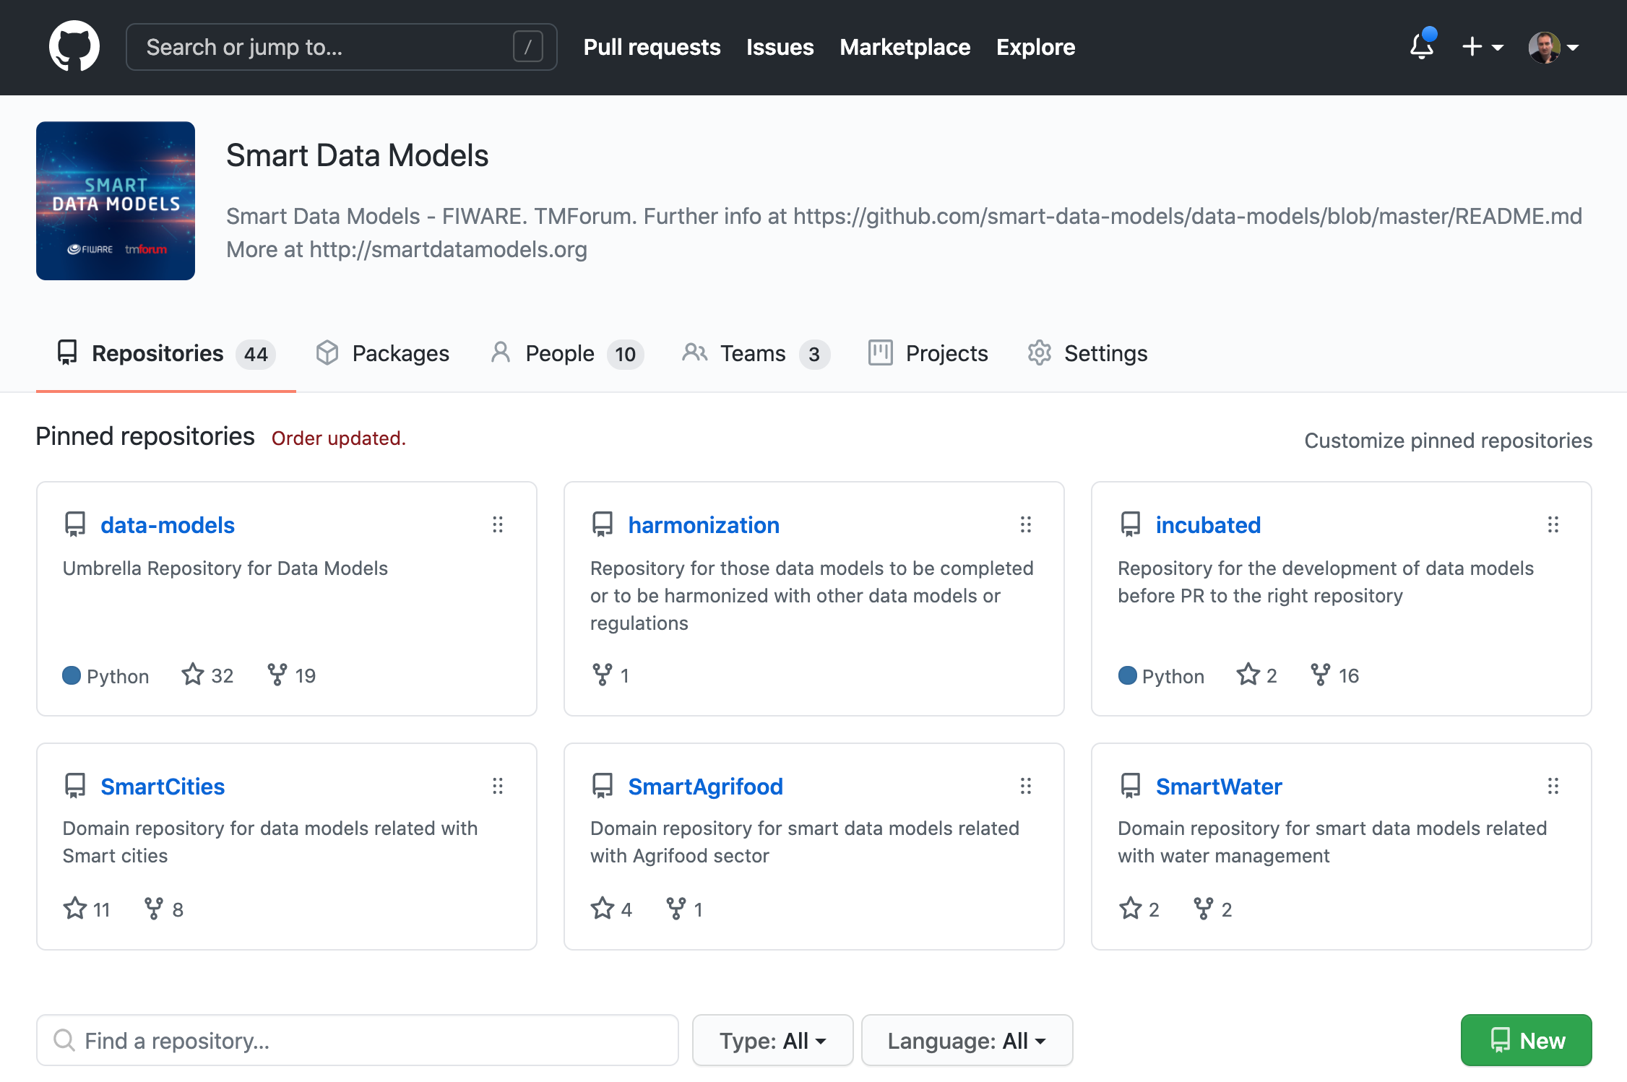
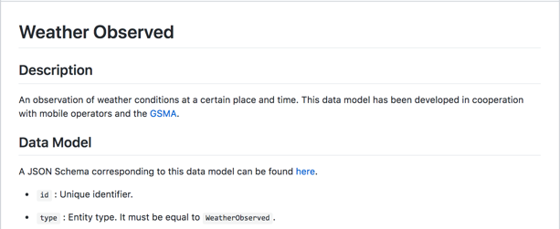
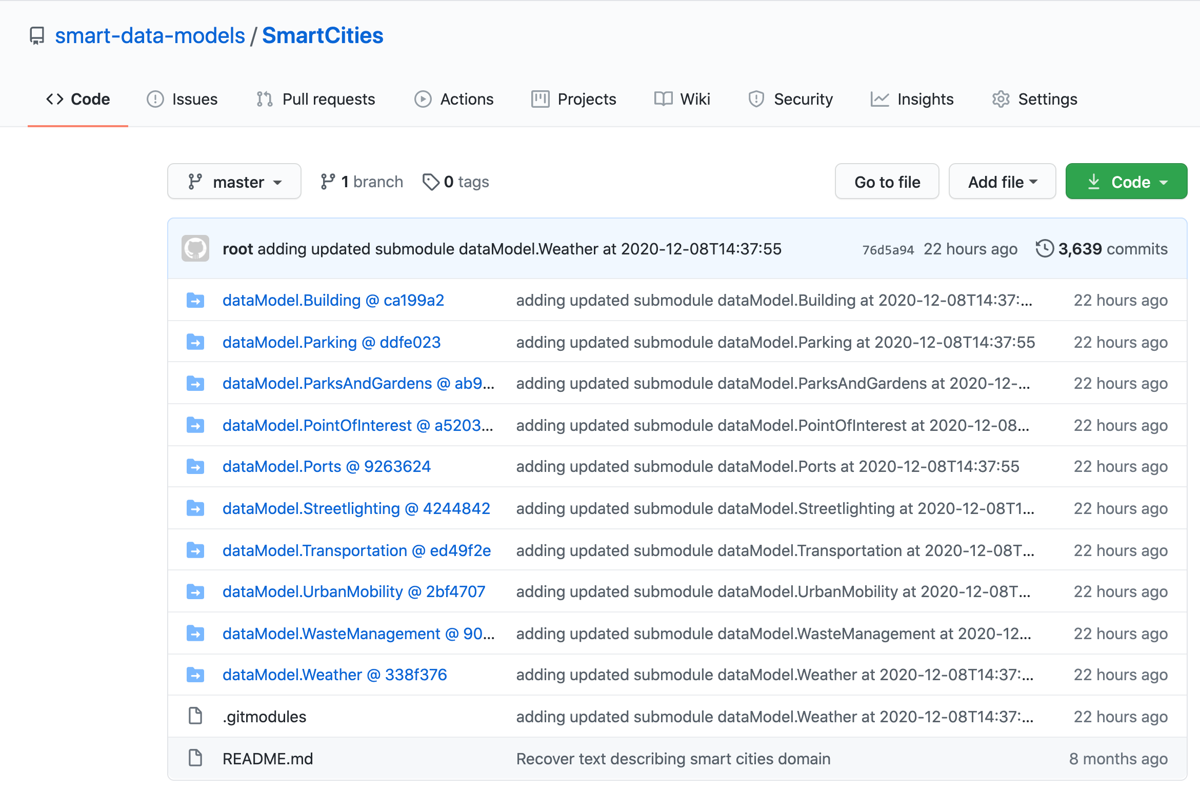
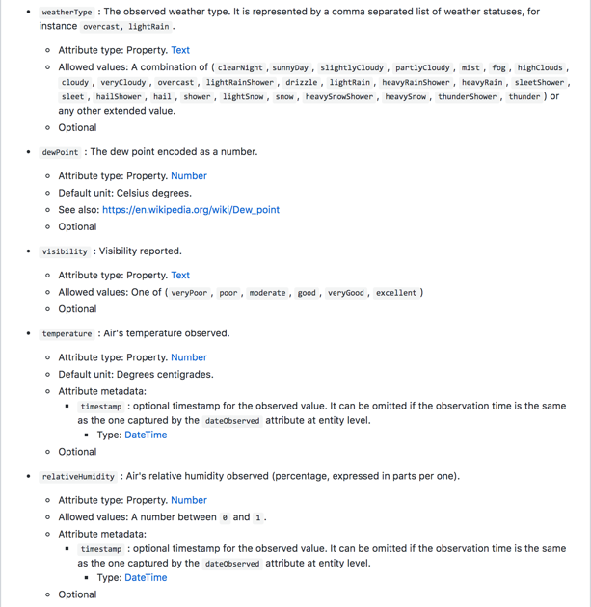
Smart Data Models
FIWARE Foundation is collaborating with relevant organizations towards definition of common data models for multiple application domains
Smart Cities
Smart Health
Smart Energy
Smart Environment
Smart Manufacturing
…
Defined data models rely on well-established ”de-facto” standards (schema.org, SAREF, IEC CIM in Energy, UNE 178503 for Tourism, …)
Provides JSON/JSON-LD Mappings compatible with NGSIv2/NGSI-LD also useful for other RESTful APIs
https://github.com/smart-data-models

Slide 22
Summary of roles in i4Trust

Slide 23

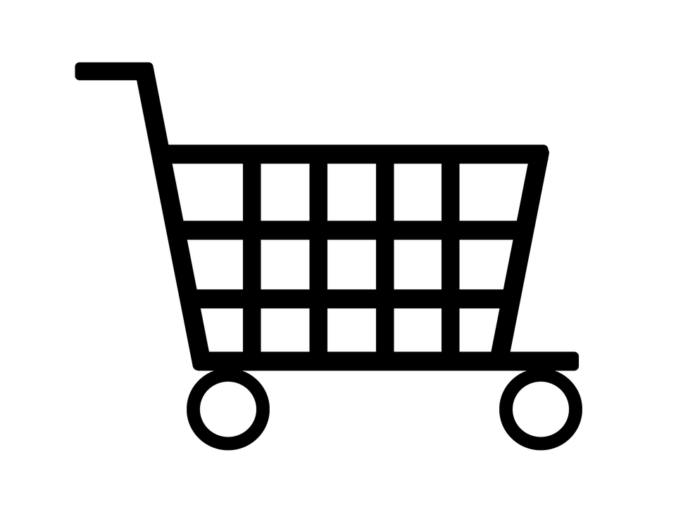
Roles in a Data Space
Data Space
Trust Provider
Data Consumer
Data Provider
Data Owner
Identity Provider
Marketplace
Authorisations Provider
Notes:
Though these roles are mentioned separately, it does not restrict an organization from playing multiple roles.
Trust Provider: Every data space needs a trust provider who acts as register of participants of the data space and keeps their status up to date. In a large data space there can be more than one trust provider. In i4Trust this role will be fulfilled by iSHARE satellite.
Data sharing roles:
Data Consumer: A party or person who consumes data provided by the data provider. The data consumer has to agree to use the data as defined by the data license under which it received the authorization to access that data.
Data Provider: A organization that hosts service to provide data on behalf of data owners. Data provider has responsibility to verify who the data consumers are and provide only data that they are authorized to have access to.
Data Owner: A party or person who owns the data in the context of the process at a given time. Do note that data owner does not have necessarily have to be data creator.
Service Provider roles:
Identity Provider: A service provider that provides authentic human identities of data consumers or data providers so that either of them can be sure that they are dealing with the right party. Identity provider also provides the level of assurance of the identity.
Authorisations Provider: A service provider that provides services to data owners to register authorisations to data consumers/data providers. Alternatively, a data owner could chose to play the role themself as long as they host the authorisation provider APIs
Marketplace: A service provider which allows data owner to publish data available for data consumers to be purchased or publish services data consumers can purchase. Marketplace enables discovery of data for data consumers.

Slide 24



Roles in i4Trust complies to iSHARE and FIWARE
Data Space
Trust Provider
iSHARE Satellite
Data Consumer
Data Provider
Context Broker
Data Owner
Identity Provider
(Keyrock)
Marketplace
FIWARE Marketplace
Authorisations Provider
(Keyrock)
Notes:
As you can see from picture that for each role iSHARE enables those roles to interact with each other using the trust framework and FIWARE provides the technology and solution to effectively share data in a data space in i4Trust.
The trust provider role is as role defined by iSHARE satellite which acts as participant register
The data consumer is the organization or person consuming service/data via a service provided by data provider while identifying itself using standards defined in iSHARE which allows them to connect to any data provider who is also iSHARE enabled.
The data provider can provide data to data consumer as authorized by data owner and FIWARE context broker technology provides intelligence and context information needed to make data meaningful.
The data owner can register authorizations over its data and specify the conditions under which data is shared which data consumer must abide by. When shared using the iSHARE trust framework the data consumer is legally obliged to use data in accordance with the conditions specified.
The Marketplace provided by FIWARE technology allows data providers and data owners to list data and/or services to offer which data consumers can buy/subscribe to. On the other hand data consumers can find offerings of relevant data from multiple data providers/owners. Besides, marketplace can act as clearing house and broker when required between the parties exchanging data so that data sharing transactions can be logged at 3rd party for auditing and billing purposes.
The identity provider role deals with the human identities with varying level of assurances as defined in eIDAS framework to support various use cases. Depending on the criticality of the data, appropriate level of assurance for identity can be provisioned.
The authorizations provider is a role which can be played by any organization as defined in iSHARE. The role only defines the interface for asking about authorizations and how the response should look like. The authorizations can be determined by using a policy database and/or transactional data from backend systems and/or existing authorizations from LDAP/AD or a combination thereof. Keyrock powered by FIWARE will provide a policy database to define policies for authorizations which can be combined with other sources to determine authorization during runtime.

Slide 25




Additionally, other service providers can provide specific services within a data space
Data Language Vocabulary Provider
Authorisations Provider Broker
Data Broker
Identity Provider Broker
Clearing Houses
Data Model Translation Provider

Slide 26
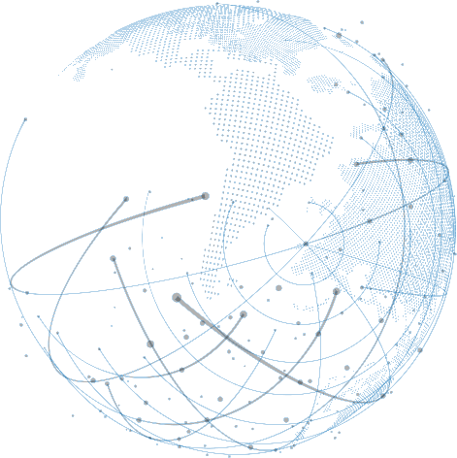




Why FIWARE: endorsement at global level
ETSI created Jan 2017 an Industry Specification Group (ISG CIM) for defining a Context Information Management API
FIWARE NGSIv2 provided the basis for the NGSI-LD specs published by ETSI
FIWARE provides several open source implementations of ETSI NGSI-LD
The GSMA has published a Reference Architecture for IoT Big Data Ecosystem which recommends to mobile operators
NGSI-LD plays the core role for the integration of components and the development of applications in the defined Reference Architecture
TM Forum supports FIWARE NGSI for real-time access to context information in cities
TM Forum and FIWARE collaborate in development of data marketplace platform components
TM Forum and FIWARE also collaborate in definition of common data models (smart data models initiative)

Slide 27


Why FIWARE: endorsement at global level
The FIWARE Context Broker Technology (hence, NGSI-LD) is a CEF (Connecting Europe Facility) Building Block recommended by the EC to public and private sector for publication of right-time context data
The European Data portal will support the publication of right-time Open Data
IUDX, which provides the trusted data exchange framework recommended to cities by the government of India, has adopted NGSI-LD as API for data exchange
IUDX will join the smart data models initiative and play a leading role in definition of data models for cities

Slide 28


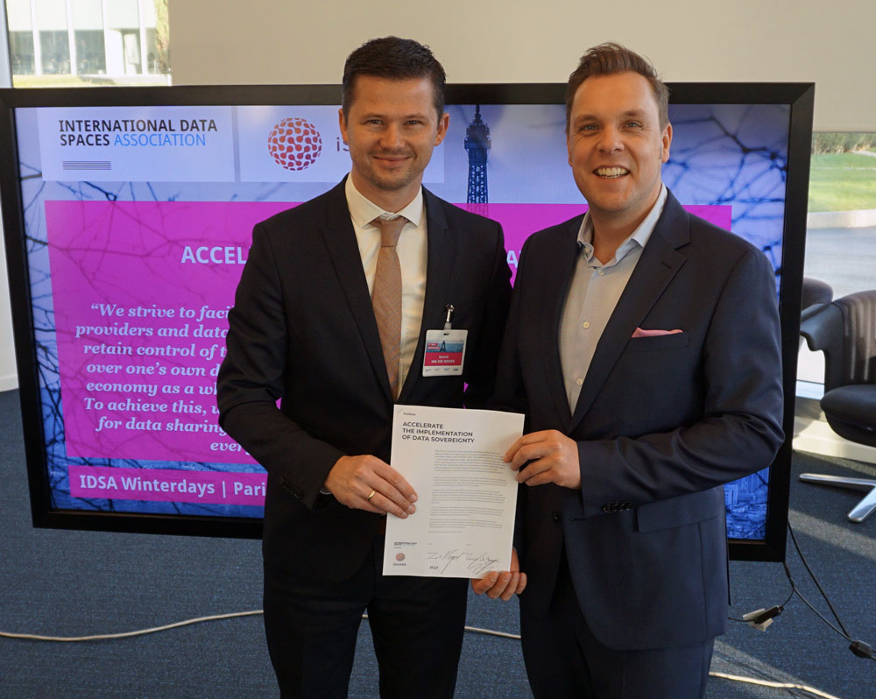

Why iSHARE
Data Sovereignty and trust start with data ownership and knowing the actors in the data space.
iSHARE is the standard for b2b data sharing trust frameworks, allowing cross domain data sharing.
iSHARE is acknowledged by IDSA as the trust framework and Participant registration (PaRIS)
Identities in the framework are based upon CEF building block eIDAS
The Data Sharing Coalition acknowledged iSHARE as the trust framework for data sharing.
iSHARE is totally federated and hence encourages more parties to start a data space on this basis.

Slide 29


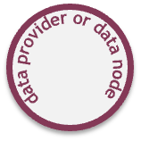

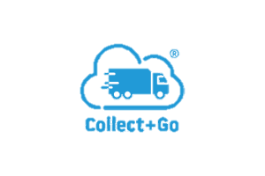

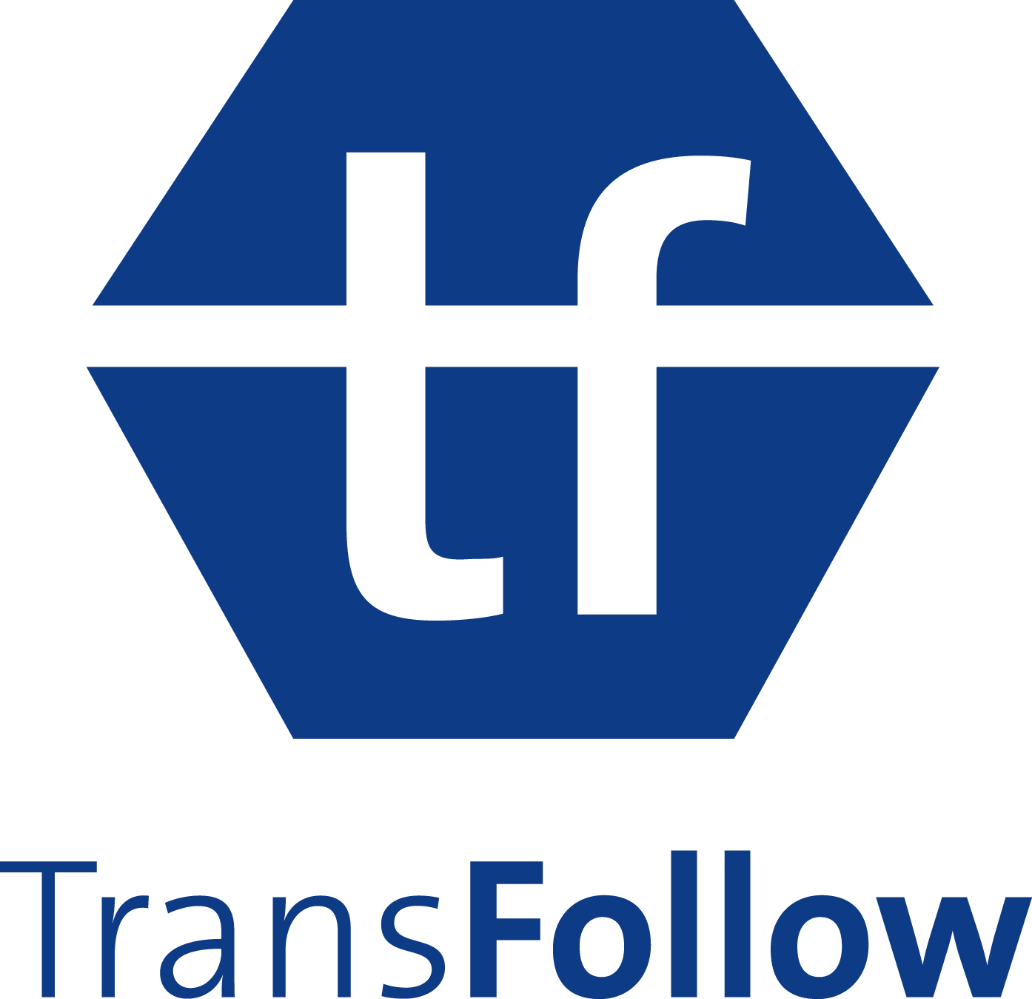







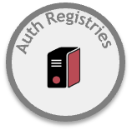




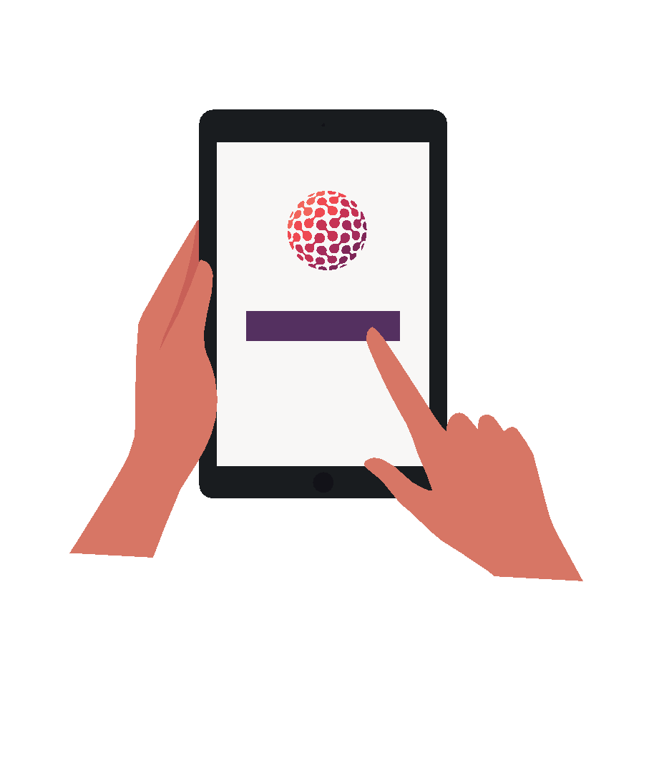

Currently operational in the Dutch Logistics Data space
which In 2021 it already covers the data of over 100.000 companies
Data Space
International Legal Framework governed by iSHARE Foundation

Slide 30
Experiments ideas
AgroFootPrintData
The idea is a service for the assessment of the carbon footprint of agricultural products in the process of growing as well as tools for sound adjustment of agro-technological, organizational and management decisions by food producers of plant origin. Participants:
1. Сustom software development & consulting company Softengi
2. Innovative company Bioinvest-Agro
Electrodo.ERM
Decentralized self-verified data broker and protocol for climate-related ESG data exchange and enterprise-level risk management (ERM) based on Digital Product Passport concept.
Participants:
SME software engineering provider 482.solutions
ActiveHouseData
Parametric digital twins of buildings will be used for optimization of a complete set of energy-efficient technologies and attraction of variants of materials and technologies.
The fully interactive 3D model will shows real-time data (lights on\off, etc.) of a digital twin using IoT sensors in a mobile device. Participants:
1. Сustom software development & consulting company Softengi
2. Architecture firm ECODAR

Slide 31

Kyrylo S. Gorokhovskyi, NaUKMA
CTO NOSC-UA DIH
fintech.lab@ukma.edu.ua
+380503837123
Website: http://cloud-5.bitp.kiev.ua/?page_id=1256&lang=en
The project is carried out within the Targeted Research Program of the National Academy of Sciences of Ukraine “Mathematical Modeling in Interdisciplinary Research of Processes and Systems Based on Intelligent Supercomputer, Grid and Cloud Technologies” for 2021-2025

